Slide 1
Model-driven Software Engineering for Connected Vehicles
Embedded Monti Arc (EMA)
Ahmed, Ana, Andreas, Anja, Lukas, Martin, Mattis
Advisor: Evgeny Kusmenko
Lab
Chair of Software Engineering
RWTH Aachen University

Slide 2
EmbeddedMontiArc Family
A C&C modeling language family
New textual approach for modeling
It includes
An architecture description language
subdividing a system into its components and sub-components (EmbeddedMontiArc),
A mathematical matrix-based behavior modeling language (MontiMath),
A stream language for model-based testing (Stream), etc.

Slide 3
EmbeddedMontiArcMath Langauge
A combination of EmbeddedMontiArc and MontiMath languages
component SensorFusion <N1 n> (Q^{1,n} (-90°:90° tilt=zeros(1,n))){
ports
in Q(0m:0.2m:10m) distance[n];
out Q(0m:0.2m:10m) mergedDistance;
implementation Math{
diag Q (0:1) ^{n,n} facMatrix = diag(cos*(tilt));
mergedDistance = min(distance * facMatrix);
}
}
EMAM
Source: “Modeling Architectures of Cyber-Physical Systems”, Kusmenko, Roth, Rumpe,von Wenckstern

Slide 4
Requirement Template
ID | Name
REQ-10 | Rerouting
Description
Upon encountering a blockage in a road or receiving a signal from another vehicle that there’s in a traffic jam (REQ-7), the vehicle should be able to change its trajectory avoiding that road and still reaching its destination.
Type | Dependencies | Approved
FR | REQ-7 | ✓
Function requirement (FR)
Non-functional requirement (NFR)
Mechanical requirement
...
Approved by the client?

Slide 5
Requirements
Fulfilled:
Following a path
Lane keeping
Upper speed limit sensors
Comfortable acceleration and steering
Battery level sensor
Object detection sensor
Next steps:
Respecting the upper speed limit
Safety distance
Collision avoidance
Intersection handling
signalized and unsignalized
Platooning

Slide 6
Architecture
Autopilot
EMA
Communication
Movement
Navigation
Environment
Behaviour

Slide 7
Architecture
EMA
Autopilot
Communication
ComOutputs
ComInputs
C2C_Info
Movement
Navigation
Environment
Behaviour

Slide 8
Architecture
Autopilot
EMA
Communication
ComOutputs
ComInputs
C2C_Info
Movement
Navigation
WeatherInfo
Environment
WeatherInfo
Behaviour

Slide 9
Architecture
Autopilot
EMA
Communication
ComOutputs
ComInputs
C2C_Info
Movement
Navigation
BehaviourInfo
WeatherInfo
Environment
WeatherInfo
Behaviour
TempoLimit

Slide 10
Architecture
EMA
Autopilot
Communication
ComOutputs
ComInputs
C2C_Info
Movement
PathInfo
CarInfo
Navigation
BehaviourInfo
HighLvlNav
WeatherInfo
Environment
WeatherInfo
Behaviour
TempoLimit

Slide 11
Architecture
EMA
Autopilot
Communication
ComOutputs
ComInputs
C2C_Info
Movement
set_gas
PathInfo
set_steering
CarInfo
set_braking
Navigation
BehaviourInfo
HighLvlNav
WeatherInfo
Environment
WeatherInfo
Behaviour
TempoLimit

Slide 12
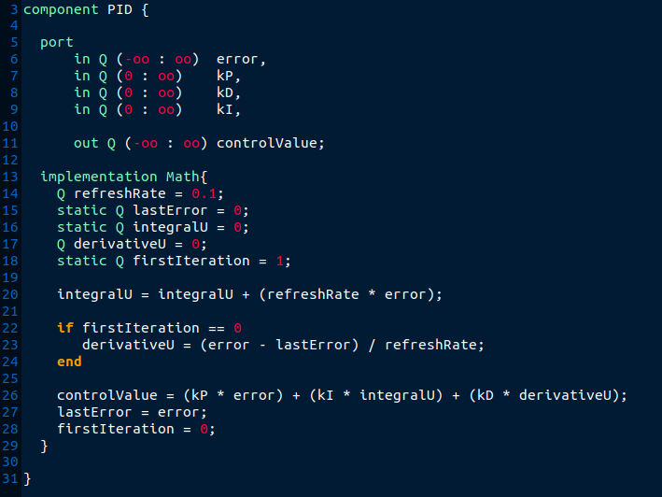
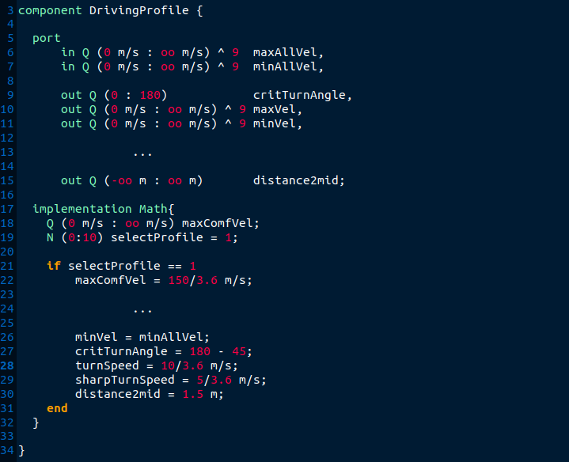
Architecture
PID
Driving Profile

Slide 13
Car 2 Car Communication – General Information
VehicleCommunication
Design and Implementation with standardized protocol
Communication with packets over sockets
General Information packet (StatePacket)
Other packets based on real-world scenarios
Optional „Authority“-flag
EMA
1:n
Scenarios
m:n
n:1
Helpers
Packets
Notes:
Designed protocol for standardized communication between the cars
Communication done via Sockets and encapsuled in a state and scenario depending packets
Cars can communicate with all other cars in transmission-range, directly or via broadcast
StatePacket transmitted via broadcast at all times
Scenario depending packets were designed on real-world scenarios -> platooning, battery-charge, traffic-jam and many more
Optional authority flag for police/emergency cars
Arch: main component is VehicleCommunication Component
VehicleCom has N scenarios; every scenario can utilize a packet and an arbitrary number of helpers

Slide 14
Car 2 Car Communication – Platooning
Platoon access:
Leadership handover
Non-leading cars follow and synchronize with leader
Join Requests, leading car decision
Leave platoon any time
Other features:
Negotiate waiting or gathering point
Request battery charging if destination not reachable
Leader signals platoon that destination was reached
Notes:
Cars can form platoons, one car takes leadership and manages who can join
The non leading cars try to synchronize the movements of the leading car -> only if secure action atm
Cars can request to join and leave at any time
If cars get delayed (accident, sudden road blockade) they can request the platoon to wait; leader can decide if platoon waits on the spot or calculate a gathering point with position of platoon and position of delayed cars to meet up
When platoon reaches destination leading car can inform other cars and initiate search for parking spots

Slide 15
Car 2 Car Communication – Flow of Communication (Emergency Braking)
SD
:Car1
:Car2
:Car3
Broadcast(StatePacket)
Broadcast(StatePacket)
Broadcast(StateUpdated)
Broadcast(StateUpdated)
Distance and Direction
Calculation
Brake
Broadcast(SafetyDistancePacket)
Broadcast(SafetyDistanceUpdated)
Broadcast(StatePacket)
Broadcast(StatePacket)
Broadcast(StateUpdated)
Broadcast(StateUpdated)
bi-directional communication
Notes:
3 Cars; all broadcasting their state; StatePacket ->Position,Velocity and Heading of car; StateUpdated -> signal that package was updated in current tick
Car3 calculates based on position difference that Car2 is too close and initiates braking
Car3 Broadcasts SafetyDistancePacket which announces the action and informs other cars about target velocity so they might brake to avoid the safety violation
After successful regulation of distance all cars resume broadcasting the StatePacket

Slide 16
Sensors
Existing:
TrueCompass
TruePosition
TrueVelocity
Implemented:
LiDAR / Object Detection Sensor
Speed Limit Sensor
Battery Sensor
Todo:
Traffic Light Sensor
Weather Sensor (temperature + humidity)

Slide 17
LiDAR / Object Detection
2 distance sensors for each direction
labeled with „front_left_lidar“, „back_left_lidar“, …
1.5m
1.49m
front
8.43m
1.12m
8.40m
1.15m
200m
200m

Slide 18
Speed Limit Sensor
double[] trajectoryX = {90.24, 102.53, 108.46, 111.12 , ...}
double[] trajectoryY = {40.56, 44.92 , 41.42 , 46.94 , ...}
double[] upper_speed_limit = {50,50,30,…}
(111.12,46.94)
(102.53,44.92)
30 km/h
50 km/h
50 km/h
(108.46,41.42)
(90.24,40.56)

Slide 19
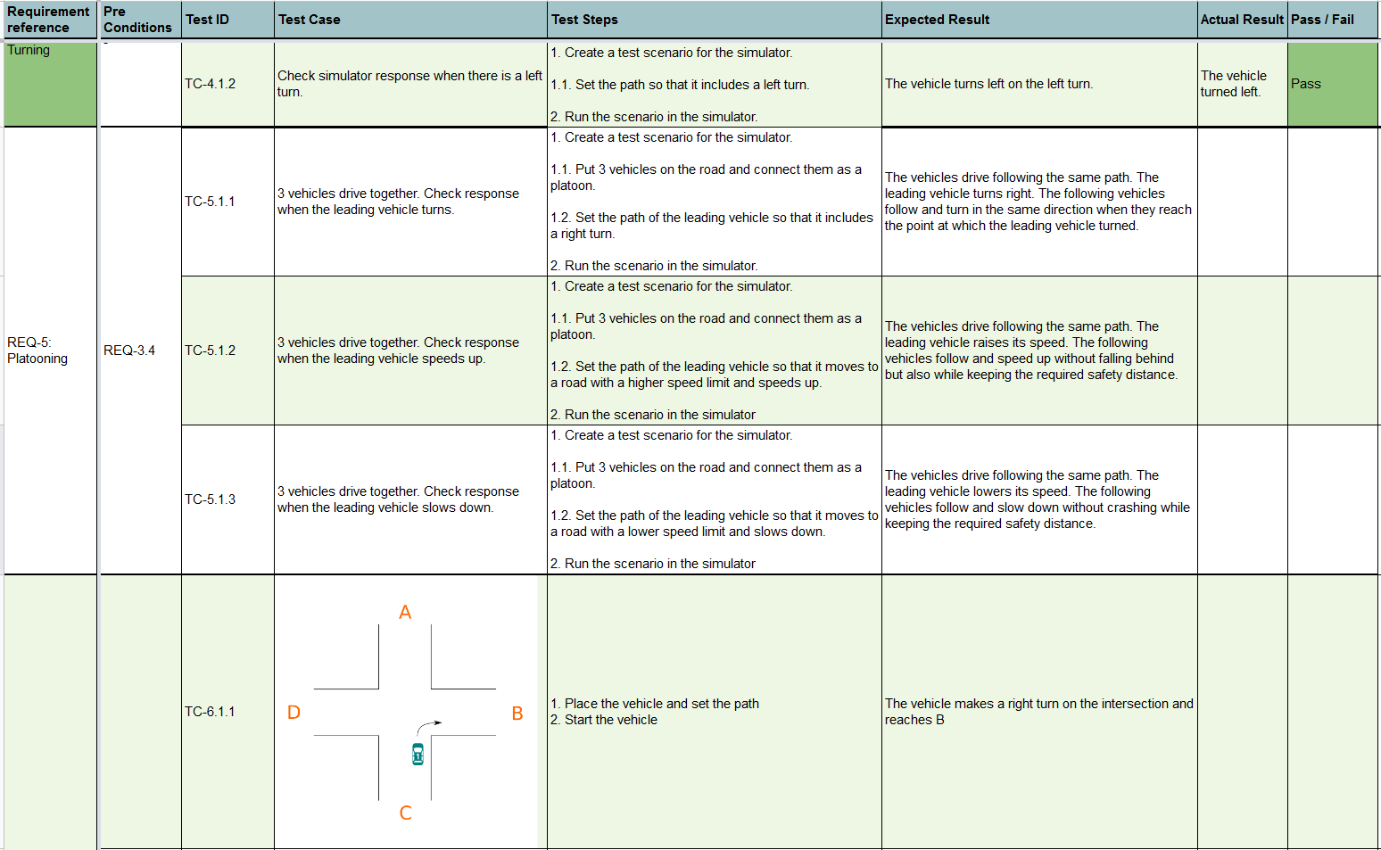
Test Scenarios
57 test cases total
26 implemented as json scenarios

Slide 20
Test Scenarios
Test ID | TC-2.1.1 | Requirement | REQ-2.1
Pre Conditions | Upper speed limit sensor exists
Description | Check vehicle response when it drives on a road with a speed limit of 50km/h.
Test Steps | 1. Place vehicle on any road of the map 2. Set a path that contains a road with a speed limit of 50 km/h. 3. Run scenario.
Expected Result | The vehicle starts driving. While driving on the road with the 50km/h speed limit, the car should have a speed between 45 km/h and 50 km/h.

Slide 21
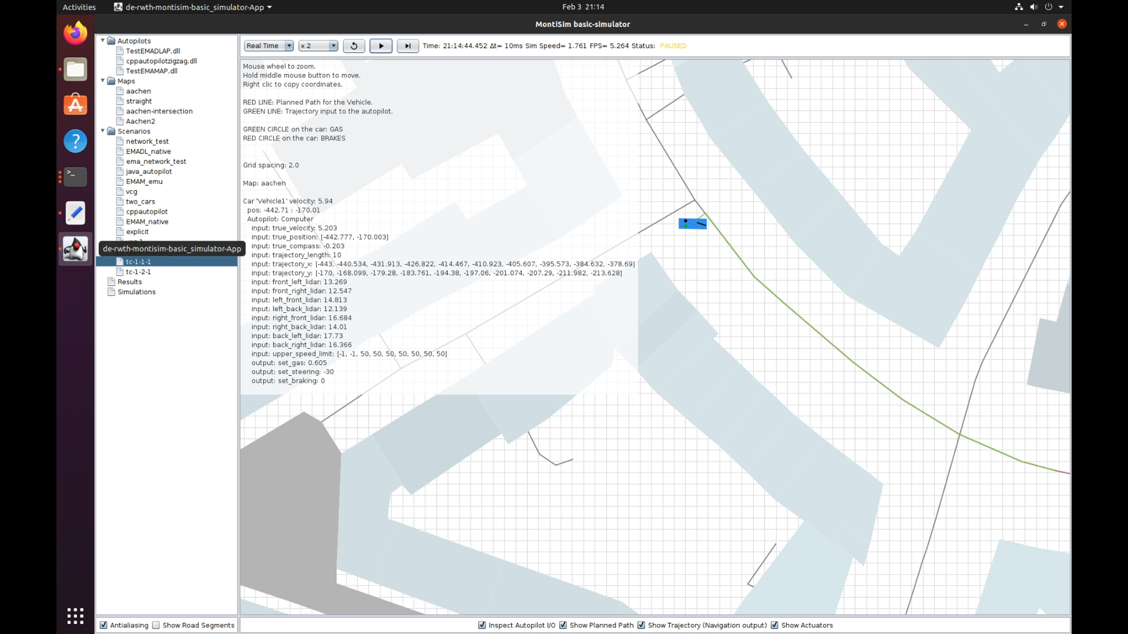
Demo

Slide 22
Summary
EMA:
Compiler error messages not expressive enough
CoCos need to be enabled/extended
Requirements:
Designed beyond scope of this lab
Easily extensible
Architecture:
Highly Modular
High cohesion and low coupling
Car 2 Car Communication:
Challenging implementation process
EMA and Simulator incompatibility issues

Slide 23
Summary
Sensors:
LiDAR Sensor and Speed-limit Sensor implemented
Missing data from simulator for other sensors
Tests-Scenarios:
Several test cases for each requirement
Not all implemented due to limitations of simulator
Outlook:
More features with simulator extension
Requirements and scenarios designed, implementation next
EMA actively developed

